Slide 1
Course Name
Newton’s laws of motion

Slide 2
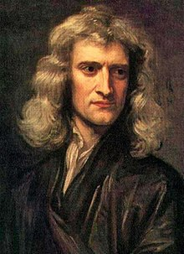
Sir Isaac Newton (1642 – 1727) was an English mathematician, astronomer, theologian, author and physicist.
He is regarded as one of the most influential scientists of all time, and a key figure in the scientific revolution.
Newton formulated the laws of motion and universal gravitation, which has dominated scientists' view of the physical universe. He worked out the “three laws of motion” governing the movement of all objects at all times an in all circumstances.

Slide 3
Newton’s 1st Law: An object at rest will stay at rest, and an object in motion will stay in motion at constant velocity, unless acted upon by an unbalanced force.
Newton’s 2nd Law: Force equals mass times acceleration.
Newton’s 3rd Law: For every action there is an equal and opposite reaction.

Slide 4
3rd Law of Motion:
For every action, there is an equal and opposite reaction.
Whenever one object exerts a force on a second object, the second object exerts an equal and opposite force on the first.

Slide 5
3rd Law of Motion:
Forces always come in pairs.
Action – reaction forces always act on different objects –> They are not balanced!
We use action – reaction forces to change our motion.

Slide 6
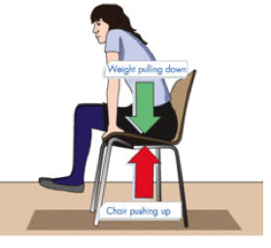
3rd Law of Motion:
Example: whenever objects A and B interact with each other, they exert forces upon each other. When you sit in your chair, your body (object A) exerts a downward force on the chair (object B) and the chair (object B) exerts an upward force on your body (object A). These two forces are called action and reaction forces.

Slide 7
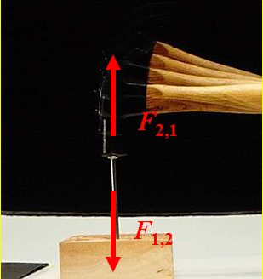
3rd Law of Motion:
Example: A hammer (object A) and a nail (object B) hit each other with equal force.

Slide 8
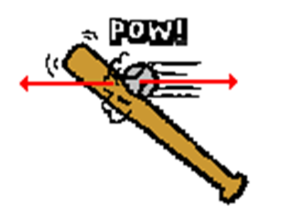
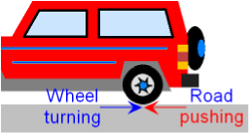
3rd Law of Motion:
Other examples:
The baseball forces the bat to the left (action); the bat forces the ball to the right (reaction).
Consider the motion of a car on the way to school. A car is equipped with wheels which spin backwards. As the wheels spin backwards, they grip the road and push the road backwards.

Slide 9
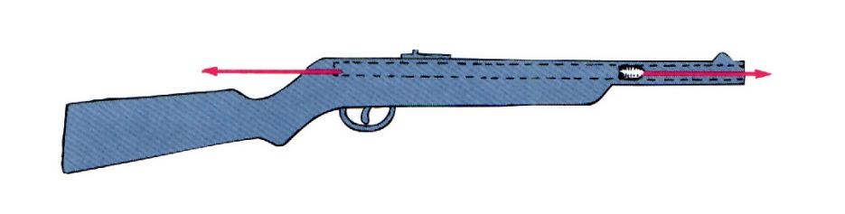
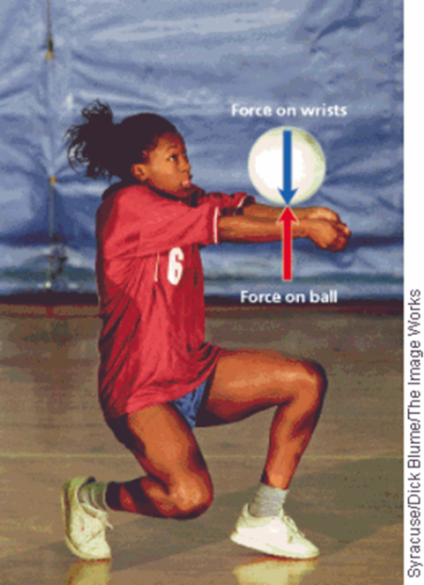
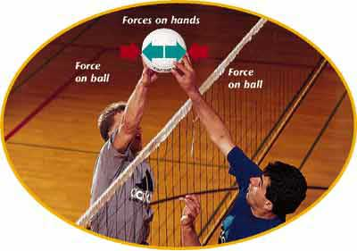
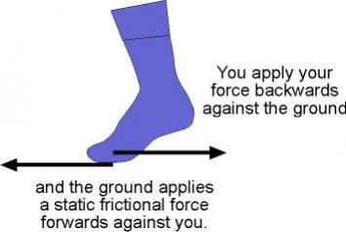
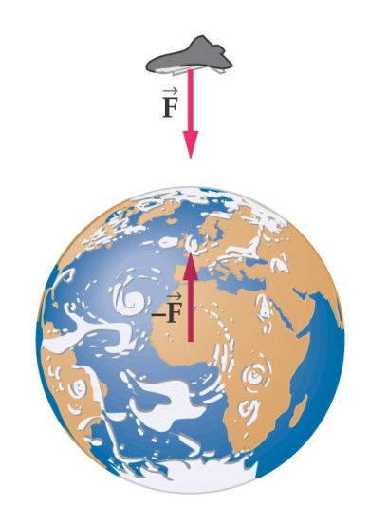
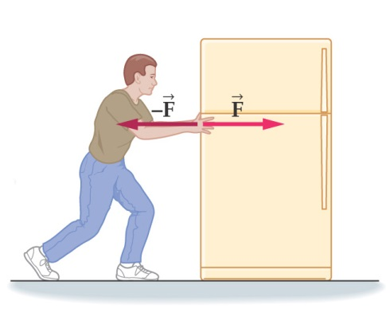
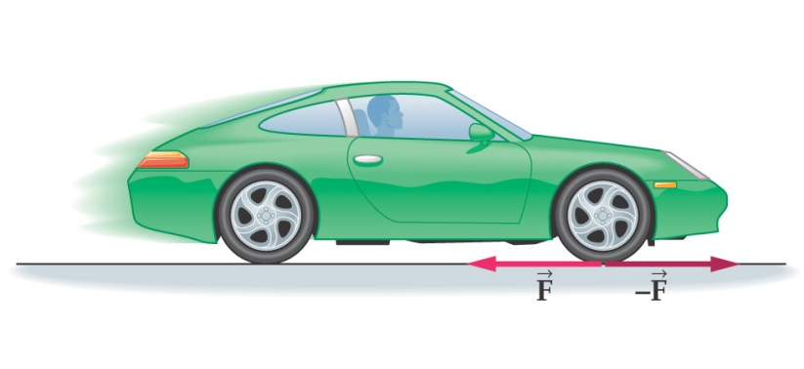
3rd Law of Motion:
Other examples:

Slide 10
References:
https://www.slideshare.net/wilsone/newtons-laws-of-motion-1949387
https://www.slideshare.net/pvnkmrksk/newtons-laws-of-motion-2587754
https://www.grc.nasa.gov/www/k-12/airplane/newton.html
http://www.physics4kids.com/files/motion_laws.html
https://phet.colorado.edu/en/simulation/forces-and-motion-basics
https://www.youtube.com/watch?time_continue=370&v=KvPF0cQUW7s
https://www.youtube.com/watch?v=NYVMlmL0BPQ
https://www.youtube.com/watch?v=3jVHQ8bECIs
https://www.youtube.com/watch?v=Ixf9ZyZaE9Q

